Slide 1
Economic implications of Supreme Court decision on GHG pricing for climate policy
Andrew Leach

Slide 2
An Economist goes to law school
Andrew Leach

Slide 3
WHY YOU SHOULD (Still) CARE ABOUT THE CONSTITUTION after the carbon pricing reference case
Andrew Leach

Slide 4
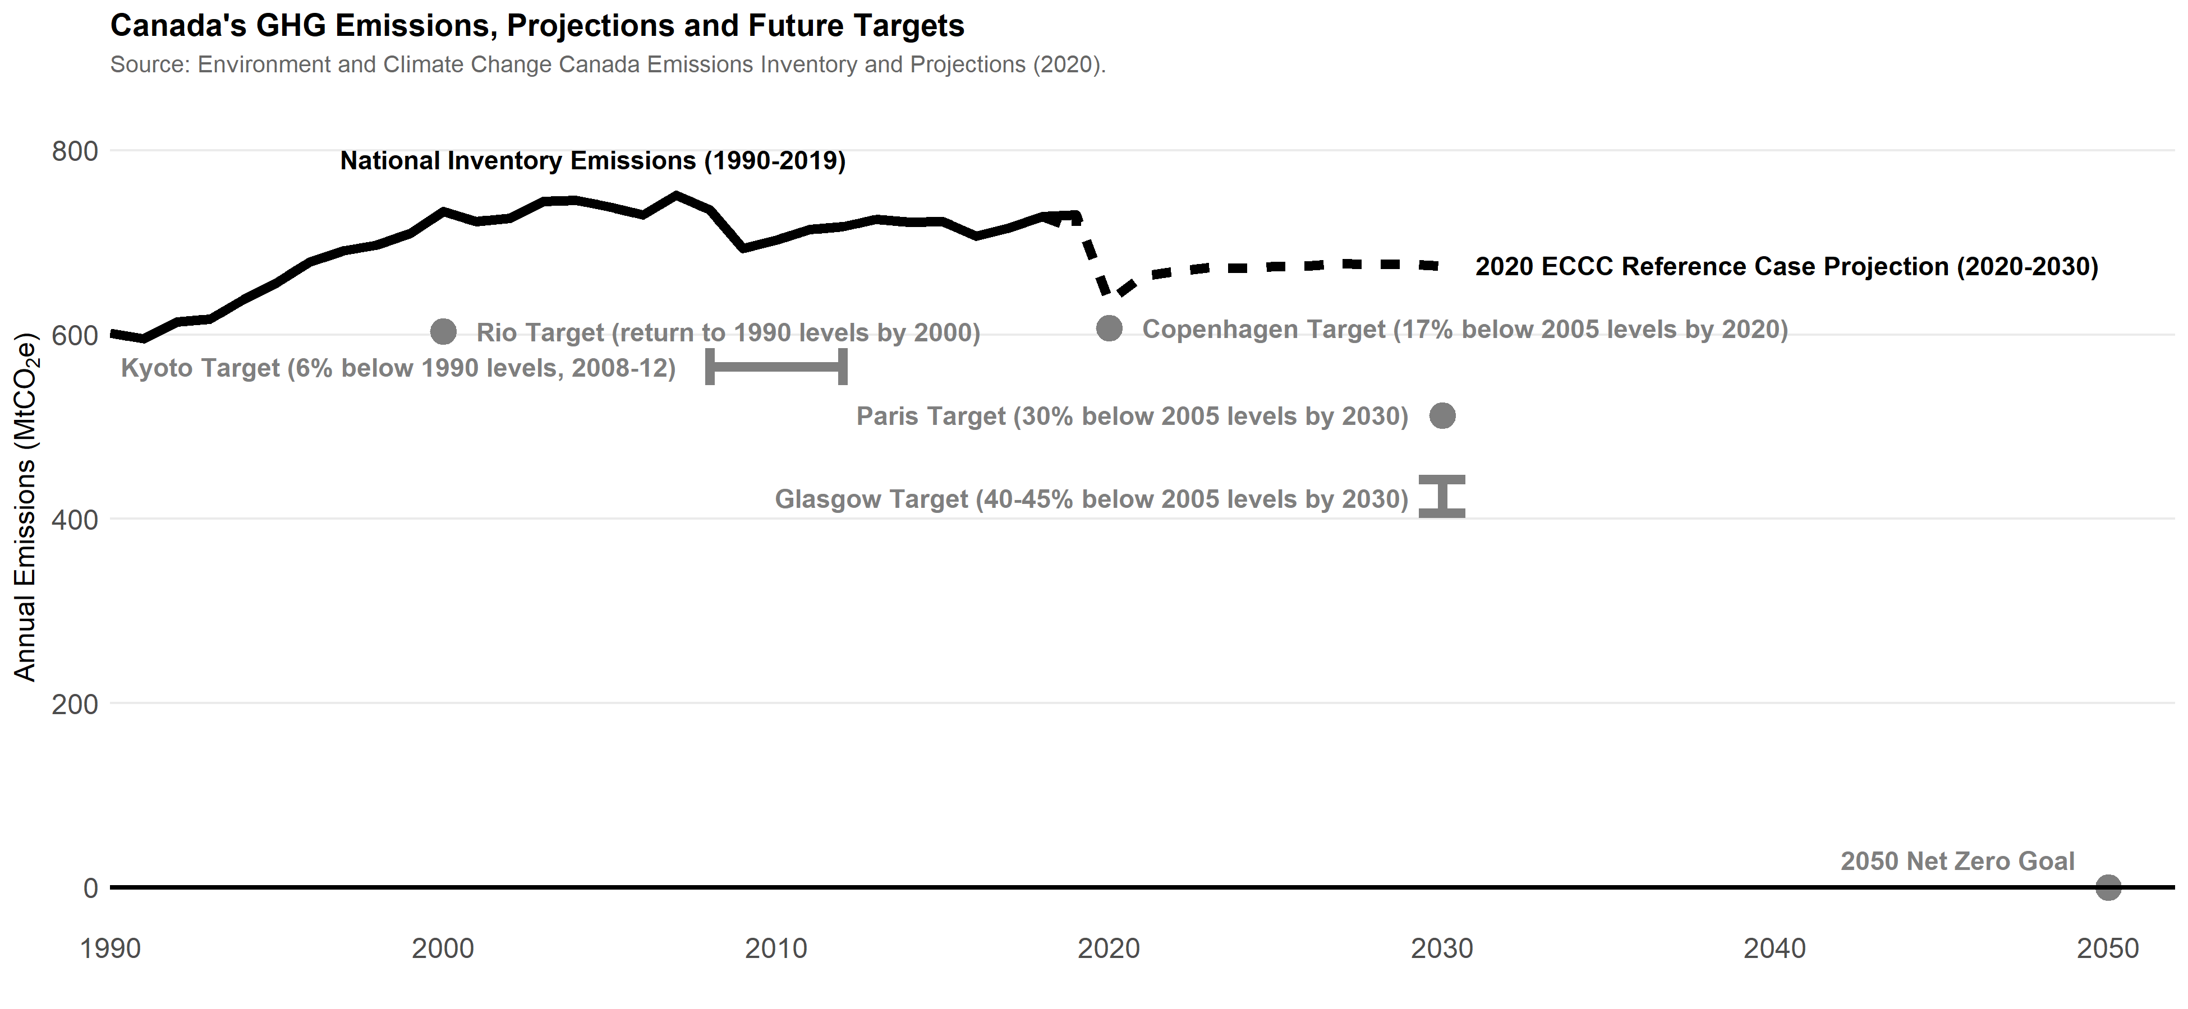
Our emissions and targets

Slide 5
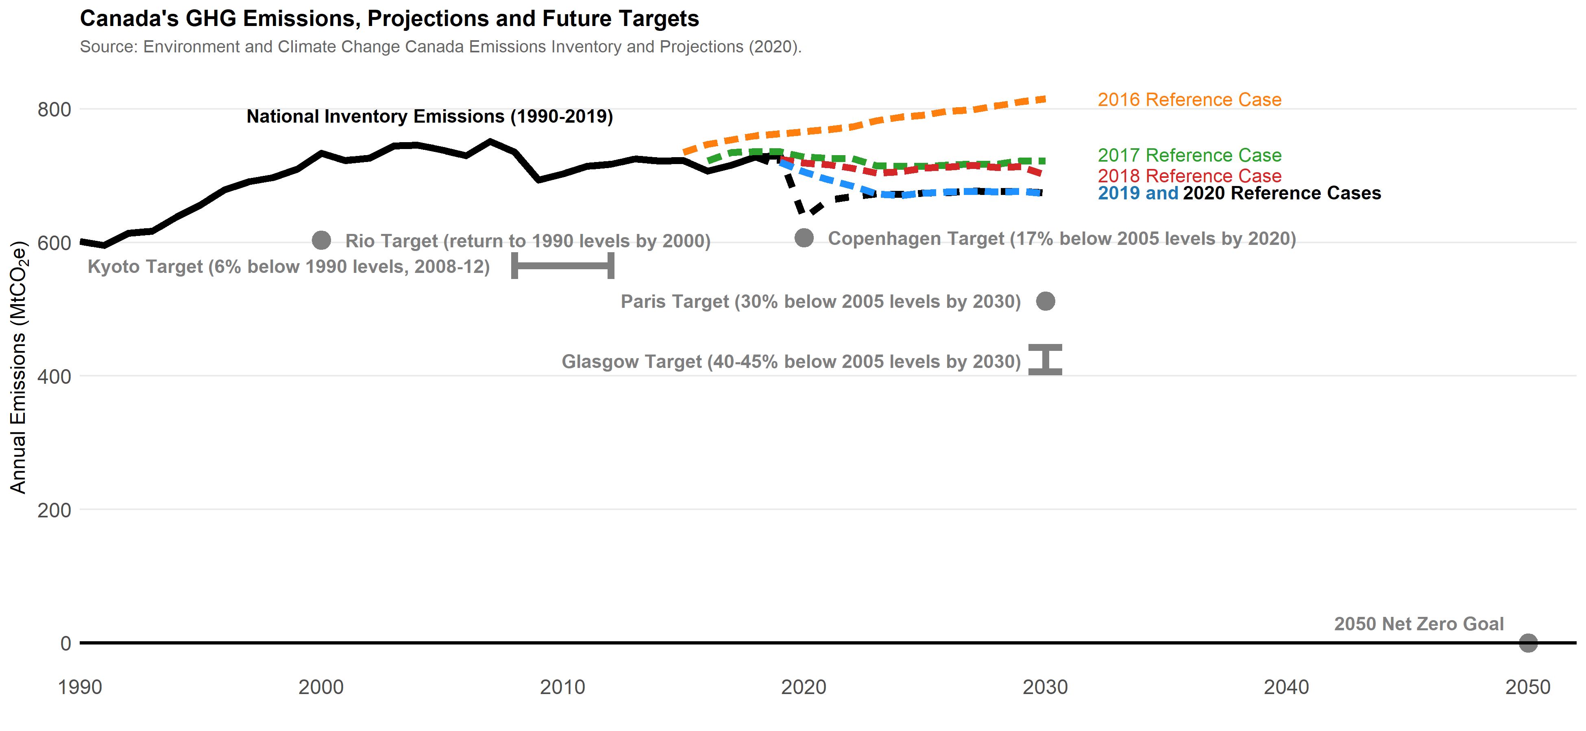
Our emissions and targets along with recent projections

Slide 6
Canada faces a significant emissions mitigation challenge
Canada’s latest emissions projections forecast levels 8-15% below 2005 levels by 2030
Budget 2021 suggested we were on track to 36% below 2005 levels by 2030
Canada’s new target is 40-45% below 2005 levels by 2030
Our emissions (2019) were estimated at 730 Mt, or equal to our 2005 levels
Globally, a 2ºC pathway implies emissions ~10% below 2005 levels by 2030
Globally, a 1.5ºC pathway implies emissions ~40% below 2005 levels by 2030

Slide 7
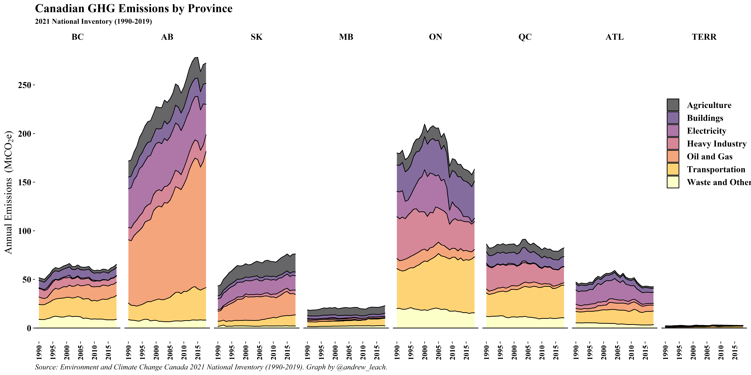
Canada faces a significant emissions mitigation challenge

Slide 8
Canada faces a significant federalism challenge

Slide 9
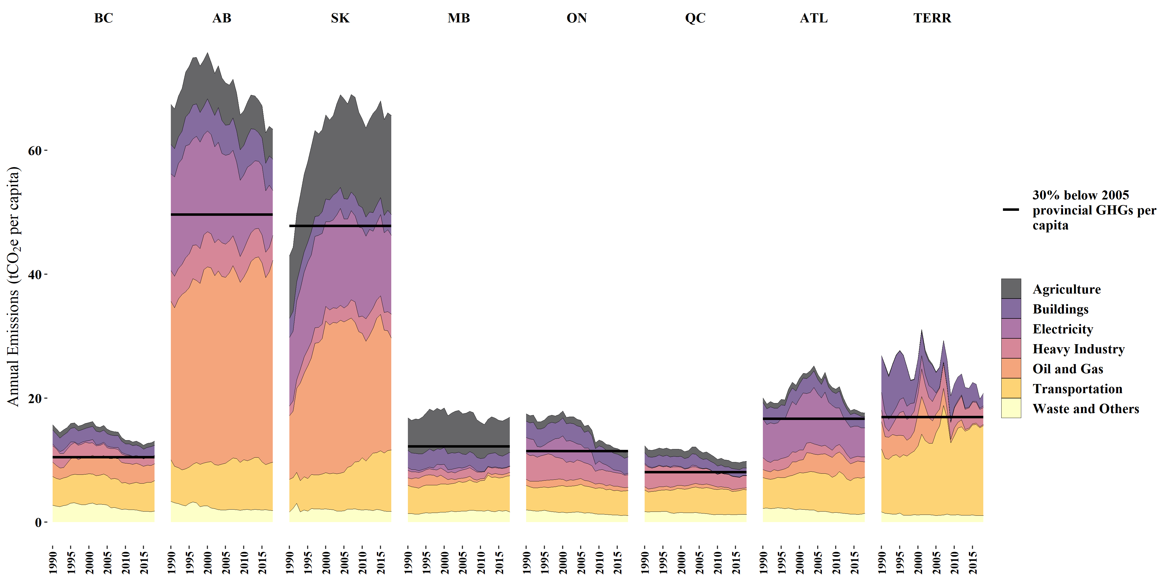
The federalism challenges leap off the page

Slide 10
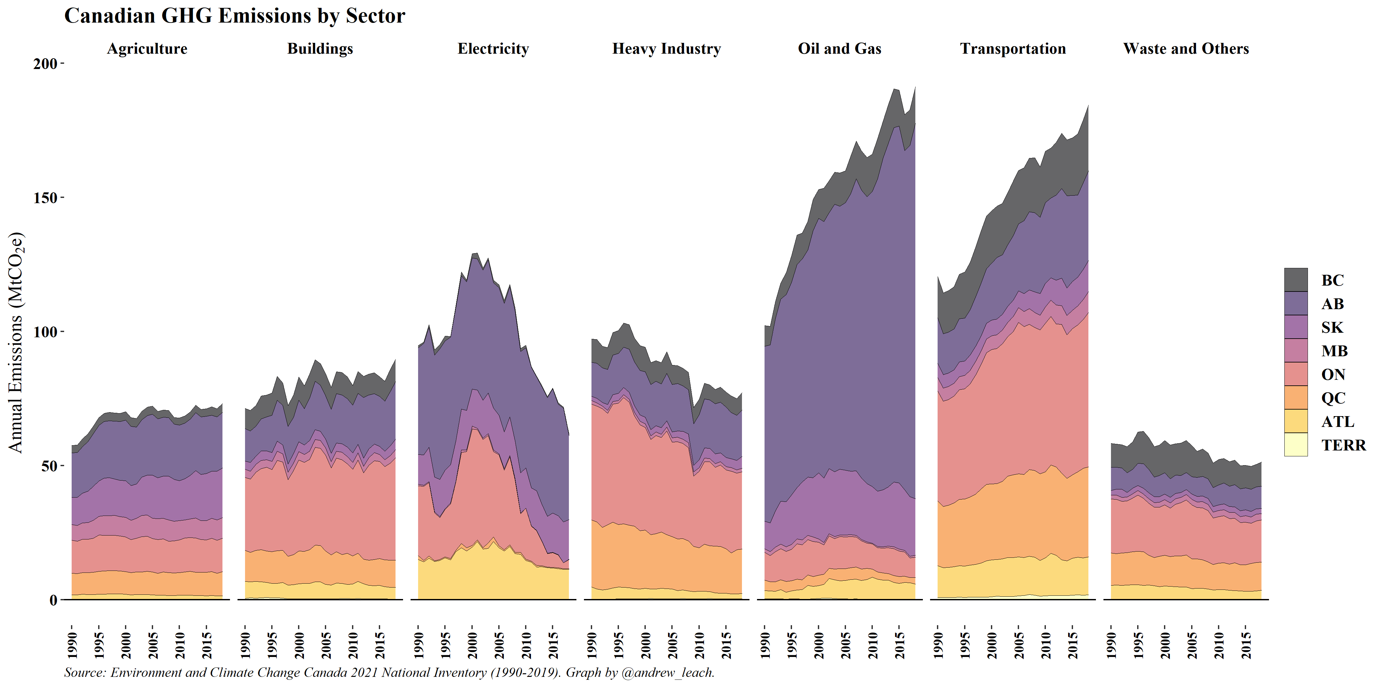
The federalism challenges leap off the page

Slide 11
The economist’s response isn’t to open a Constitutional Law book!
Perhaps it should be:
  The Constitution imposes significant constraints on the exercise of different types of policies by different levels of government
  If we’re serious about the economics of the Second Best, we need to keep in mind constraints and distortions

Slide 12
The economist’s response isn’t to open a Constitutional Law book!
Perhaps it should be:
  The Constitution imposes significant constraints on the exercise of different types of policies by different levels of government
  If we’re serious about the economics of the Second Best, we need to keep in mind constraints and distortions
There’s another reason:
  At first glance, the Constitution can seem easy to interpret, but in many cases that interpretation is more complex
  We don’t want to make recommendations that are offside with the law

Slide 13
Climate policy raises several important constitutional questions
Which level of government should address climate change
  Both?
  Federal?
  Provincial?
Which tools are available to the different levels of government?
How is Canada’s situation different from that faced by other countries?
The 2021 Greenhouse Gas Pollution Pricing Act decision resolves some – but not many or nearly enough – of these questions.

Slide 14
Environmental economics meets the law
Economists prefer carbon prices to command-and-control policies as they deliver cost-effective emissions reductions
Economists’ equi-marginal principle tells us that national carbon pricing will likely be the lowest-cost policy when compared to a patchwork of provincial policies
But, policy effectiveness doesn’t confer jurisdiction
  whether a subject should or would best be regulated federally or provincially as a matter of optimal policy is irrelevant to the constitutional validity of the legislation.
See Re: Securities Act at para 90, Re: Firearms Act at para 18, R v. Morgentaler at 487-88, and re Anti-Inflation Act at 468.

Slide 15
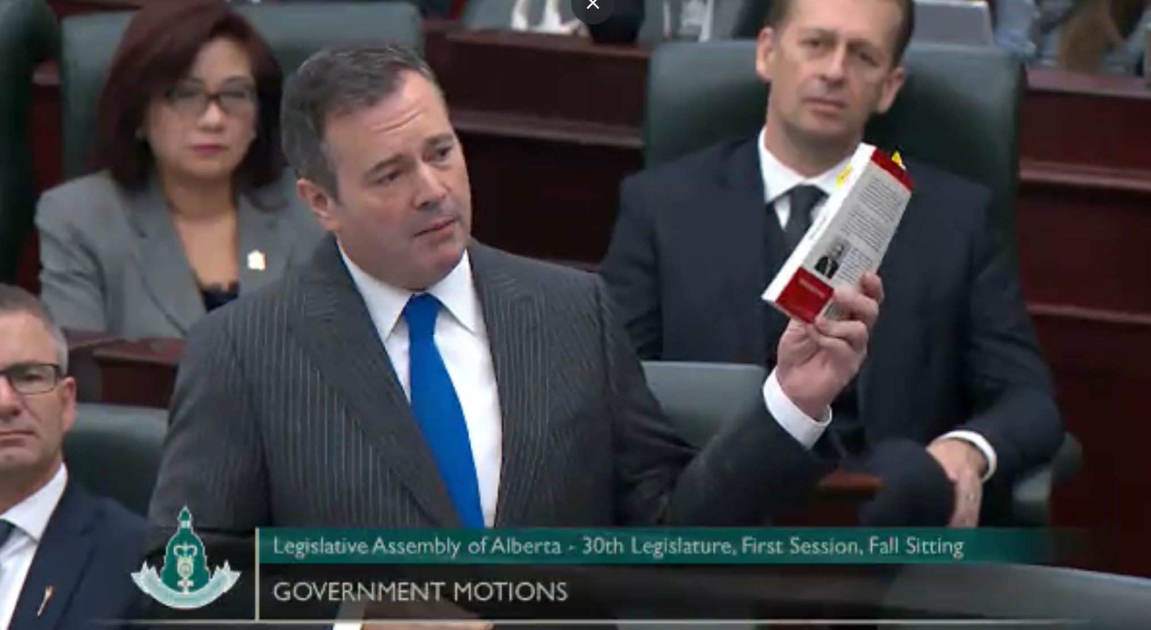
A digression on the division of powers

Slide 16
National GHG policy is challenging
Climate change nor the environment are heads of federal power
    Friends of the Oldman River Society v Canada (Minister of Transport), [1992] 1 SCR 3 [Oldman River] at 63–4 held that jurisdiction is shared between federal and provincial governments
Canada has no effective treaty or foreign affairs power
    Constitution Act, 1867, s. 132 and Canada (Attorney General) v Ontario (Attorney General), [1937] 1 DLR 673 (PC)
Canada has a weak trade and commerce power
Parliament can’t legislate in areas of provincial legislative jurisdiction
  See Parsons, Insurance Reference, Board of Commerce, Natural Products Marketing , Anti-Inflation, re Securities Act
Sweeping federal powers (POGG, trade and commerce, and criminal law) are subject to tests of incursion into provincial jurisdiction
  See Board of Commerce, Crown Zellerbach, Re: Securities Act, Hydro-Québec, Re: Assisted Human Reproduction.
Taxation power is nowhere near as powerful as you think it is

Slide 17
The Federal Power: Sections 91, 92(10), and 132
Relevant enumerated powers in Section 91
  (2) The Regulation of Trade and Commerce.
  (3) The raising of Money by any Mode or System of Taxation.
  (27) The Criminal Law, except the Constitution of Courts of Criminal Jurisdiction, but including the Procedure in Criminal Matters.
  (29) Such Classes of Subjects as are expressly excepted in the Enumeration of the Classes of Subjects by this Act assigned exclusively to the Legislatures of the Provinces.

Slide 18
The Federal Power: Sections 91, 92(10), and 132
92. In each Province the Legislature may exclusively make Laws in relation to Matters coming within the Classes of Subjects next hereinafter enumerated; that is to say,
  (10) Local Works and Undertakings other than:
  Lines of Steam or other Ships, Railways, Canals, Telegraphs, and other Works and Undertakings connecting the Province with any other or others of the Provinces, or extending beyond the Limits of the Province;
    e.g. railways pipelines and power transmission
  (c) Such Works as, although wholly situate within the Province, are before or after their Execution declared by the Parliament of Canada to be for the general Advantage of Canada or for the Advantage of Two or more of the Provinces.
  e.g. atomic energy

Slide 19
National GHG policy is challenging
Climate change nor the environment are heads of federal power
    Friends of the Oldman River Society v Canada (Minister of Transport), [1992] 1 SCR 3 [Oldman River] at 63–4 held that jurisdiction is shared between federal and provincial governments
Canada has no effective treaty or foreign affairs power
    Constitution Act, 1867, s. 132 and Canada (Attorney General) v Ontario (Attorney General), [1937] 1 DLR 673 (PC)
Canada has a weak trade and commerce power
Parliament can’t legislate in areas of provincial legislative jurisdiction
  See Parsons, Insurance Reference, Board of Commerce, Natural Products Marketing , Anti-Inflation, re Securities Act
Sweeping federal powers (POGG, trade and commerce, and criminal law) are subject to tests of incursion into provincial jurisdiction
  See Board of Commerce, Crown Zellerbach, Re: Securities Act, Hydro-Québec, Re: Assisted Human Reproduction.
Taxation power is nowhere near as powerful as you think it is

Slide 20
But, we signed the Paris agreement!
  Treaty Obligations
  132. The Parliament and Government of Canada shall have all Powers necessary or proper for performing the Obligations of Canada or of any Province thereof, as Part of the British Empire, towards Foreign Countries, arising under Treaties between the Empire and such Foreign Countries.
  Canada’s much weaker treaty power compared to other commonwealth countries, and even compared to the US means that the Paris agreement doesn’t confer jurisdiction to the federal government
  Treaties have been cited as part of the national concern argument in POGG cases (Aeronautics, Radio and Telecom, Crown Zellerbach, and now the GGPPA References.

Slide 21
National GHG policy is challenging
Climate change nor the environment are heads of federal power
    Friends of the Oldman River Society v Canada (Minister of Transport), [1992] 1 SCR 3 [Oldman River] at 63–4 held that jurisdiction is shared between federal and provincial governments
Canada has no effective treaty or foreign affairs power
    Constitution Act, 1867, s. 132 and Canada (Attorney General) v Ontario (Attorney General), [1937] 1 DLR 673 (PC)
Canada has a weak trade and commerce power
Parliament can’t legislate in areas of provincial legislative jurisdiction
  See Parsons, Insurance Reference, Board of Commerce, Natural Products Marketing , Anti-Inflation, re Securities Act
Sweeping federal powers (POGG, trade and commerce, and criminal law) are subject to tests of incursion into provincial jurisdiction
  See Board of Commerce, Crown Zellerbach, Re: Securities Act, Hydro-Québec, Re: Assisted Human Reproduction.
Taxation power is nowhere near as powerful as you think it is

Slide 22
The Provincial Powers: Sections 92, 92A and 125
92. In each Province the Legislature may exclusively make Laws in relation to Matters coming within the Classes of Subjects next hereinafter enumerated; that is to say:
  2. Direct Taxation within the Province in order to the raising of a Revenue for Provincial Purposes.
  9. Licensing regimes
  10. Local Works and Undertakings
  13. Property and Civil Rights in the Province.
  16. Generally all Matters of a merely local or private Nature in the Province.
92A. Natural Resources, incl. management, taxation, non-exclusive authority over exports, as well as electricity (ex nuclear which is federal)
125. No Lands or Property belonging to Canada or any Province shall be liable to Taxation.

Slide 23
National GHG policy is challenging
Climate change nor the environment are heads of federal power
    Friends of the Oldman River Society v Canada (Minister of Transport), [1992] 1 SCR 3 [Oldman River] at 63–4 held that jurisdiction is shared between federal and provincial governments
Canada has no effective treaty or foreign affairs power
    Constitution Act, 1867, s. 132 and Canada (Attorney General) v Ontario (Attorney General), [1937] 1 DLR 673 (PC)
Canada has a weak trade and commerce power
Parliament can’t legislate in areas of provincial legislative jurisdiction
  See Parsons, Insurance Reference, Board of Commerce, Natural Products Marketing , Anti-Inflation, re Securities Act
Sweeping federal powers (POGG, trade and commerce, and criminal law) are subject to tests of incursion into provincial jurisdiction
  See Board of Commerce, Crown Zellerbach, Re: Securities Act, Hydro-Québec, Re: Assisted Human Reproduction.
Taxation power is nowhere near as powerful as you think it is

Slide 24
When is a tax not a tax? Westbank
Courts have been asked to define what is and is not a tax. Why?
  s. 125 “prohibits one level of government from taxing the property of the other. […][I]t does not prohibit the levying of user fees or other regulatory charges properly enacted within the government’s sphere of jurisdiction.
Westbank imposes a 5-part test of what constitutes a tax:
  compulsory and enforceable by law;
  imposed under the authority of the legislature;
  levied by a public body;
  intended for a public purpose;
  unconnected to any form of a regulatory scheme.
    A regulatory scheme would include policies intended to change behaviour
  Westbank First Nation v. British Columbia Hydro and Power Authority, [1999] 3 S.C.R. 134

Slide 25
Double-aspect and paramountcy
Double-aspect doctrine: two levels of government may make laws in relation to one subject area so long as the laws pursue an objective (regulate an aspect) within their jurisdiction
  Canadian Western Bank v. Alberta, [2007] 2 SCR 3 or Spraytech v Hudson, [2001] 2 S.C.R. 241, Ontario Hydro v. Ontario (Labour Relations Board), [1993] 3 SCR. 327.
Paramountcy holds that where there is conflict between otherwise valid federal and provincial laws, federal law prevails
  What is conflict?
    Joint compliance with federal and provincial laws is not possible – we’ll see the limits of this in Redwater
    Provincial law frustrates a federal purpose – this may yet come into play for GHG policies
  Does not apply broadly to subject areas or even to subject matters in *most* cases
    Federal laws can’t validly cover the field unless there is no valid anchor for provincial law
Provincial jurisdiction over an area affected by climate policy does not preclude valid federal legislation

Slide 26
Canada has a long history of Premiers fighting federal overreach

Slide 27
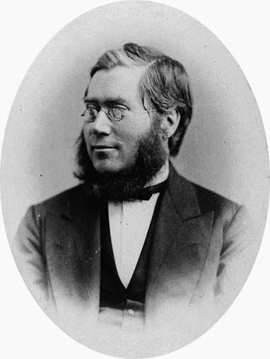
Canada has a long history of Premiers fighting federal overreach

Slide 28
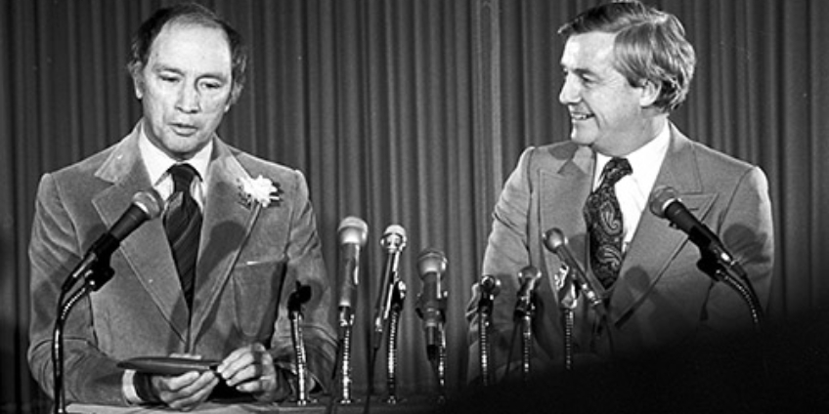
Canada has a long history of Premiers fighting federal overreach

Slide 29
Enter the GGPPA
Trudeau’s national carbon pricing legislation
  A federal backstop, not a pure national carbon price
  Applies nowhere by default – provinces must be listed in order for carbon to be priced in that province
Challenged by governments of Ontario, Saskatchewan, and Alberta
  Legislation upheld in Ontario and Saskatchewan
  Alberta Court of Appeal advised that the GGPPA was unconstitutional
All three decisions were appealed to the Supreme Court of Canada

Slide 30
What exactly does the GGPPA do?
Two main sections of the legislation
  Part I imposes a fuel charge in provinces listed in a Schedule to the GGPPA at rates calculated based on the emissions content of fuels
  Part II establishes a separate regulatory framework for large emitters, or those with annual emissions greater than 10,000 tonnes per year
    Same carbon price schedule as Part I
    Facilities receive an output-based allocation of emissions credits which some foolishly characterize as a performance standard
What is not in the legislation?
  The legislation does not invalidate, over-ride, or in any material way interfere with provincial legislation any more than federal income taxes interfere with provincial income taxes
  The legislation does not set performance standards or otherwise regulate technology, production, or individual activities or behaviour

Slide 31
What is the court deciding in a constitutional case?
Court’s role is to decide what the law does, in pith and substance, and then to determine whether that purpose and effect fits within a federal head of power
  Characterization and classification
A law is assumed to be constitutional, and the case must be made by those challenging it
It’s not sufficient to show that another level of government could enact the same legislation – recall double aspect
Many of the heads of power have accepted tests for classification that that court may follow or update

Slide 32
Canada argued the GGPPA was a valid exercise of POGG
The general POGG power in s. 91:
  It shall be lawful for the Queen, by and with the Advice and Consent of the Senate and House of Commons, to make Laws for the Peace, Order, and good Government of Canada, in relation to all Matters not coming within the Classes of Subjects by this Act assigned exclusively to the Legislatures of the Provinces;
Other interveners argued that the law could be classified under the federal powers to legislate:
  s. 91(2). The Regulation of Trade and Commerce.
  s. 91(3). The raising of Money by any Mode or System of Taxation.
  s. 91(27). The Criminal Law

Slide 33
What did the SCC FinD?

Slide 34
The GGPPA is intra vires Parliament!
Majority opinion of Wagner C.J. (Abella, Moldaver, Karakatsanis, Martin and Kasirer JJ. concurring) held that “establishing minimum national standards of GHG price stringency to reduce GHG emissions” is within Parliament’s POGG powers (para 207, with the matter at hand clearly limited at para 168)
Four key aspects (get it?) of the decision:
  While POGG is exclusively federal, jurisdiction under POGG is not plenary and the double aspect doctrine applies (paras 120-31)
  There are myriad aspects of GHG emissions which lie beyond the provincial ambit (paras 142-57 and 167-71)
  The backstop attributes of the GGPPA sufficiently limit its intrusion into provincial jurisdiction to satisfy the Crown Zellerbach test
  GGPPA-imposed carbon prices are regulatory charges and such charges are consistent with the POGG power (paras 212-219)and are not taxes

Slide 35
Aspects of the decision for further thought
Clear explanation of the light touch of federal regulation under the GGPPA raises questions for other federal policies (para 71 and dissents)
Wagner C.J. struggles with the consistent application of minimum standards vs. regulatory charges such that the logic of the decision isn’t compelling
  Wagner errs in describing the effects of the standards at para 79 re: what provinces are permitted to do and further at para 81.
  Dissent of Brown J. is correct on this point IMO.
Wagner C.J. frames the GGPPA as selective delegation to the provinces, a characterization that should have carried the day
Dissent of Rowe J. likely prescient and should not have been dismissed out of hand by the majority (para 220), especially when the majority itself moots multiple potential avenues for judicial review of regulations

Slide 36
What does it tell us about other policies that might be imposed
The GGPPA decision is very narrow so it tells us little about other policies imposed federally:
    Carbon taxes or regulatory charges without a backstop element
    Cap-and-trade programs
    Hybrid policies (Alberta’s SGER/CCIR/TIER and the GGPPA if you ignore the backstop)
    Facility-level regulations
Legal scholars (myself included now!) continue to argue about what the federal government might be able to do legislatively
  Some argued that the criminal law power offers broad reach for federal action
  Others (Chalifour, for example), have argued that POGG can anchor for most policies
  I argue that POGG or the trade and commerce power could anchor some classes of emissions pricing policies, but others face familiar challenges that have plagued other federal economic policies

Slide 37
Conclusions
The federal government has the capacity to implement GHG emissions policies, and has already done so in several cases
The Constitution imposes substantial limits on federal policies
Criminal law, POGG, and perhaps the trade and commerce power open the doors to a wide array of policy options
The extra-provincial branch of the trade and commerce power adds less than many assume to Parliament’s options
The GGPPA case may be among the important Canadian economic policy cases, but not because it settled the question of federal powers
The GGPPA will certainly not be the last climate policy case to reach the SCC

Slide 38
Contact Information
Andrew Leach
University of Alberta School of Business
andrew.leach@ualberta.ca
Twitter: @andrew_leach

